Slide 1
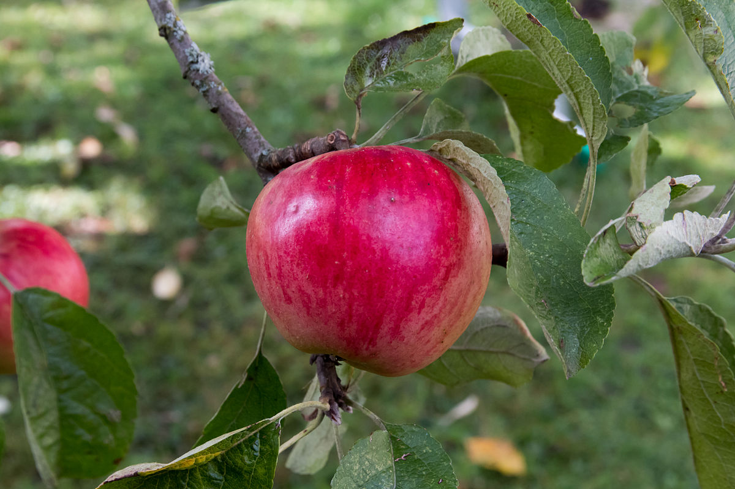
Apples

Slide 2
A Section:
Pick those apples now! Clean them up to sell!
Pick them, clean them, you know how!
Go Pick those apples now! Clean them up to sell!
Pick them, clean them, you know how!

Slide 3
B Section:
Johnathon, sweet and juicy,
Johnathon, sweet and juicy,
Johnathon, sweet and juicy,
Taste so good!

Slide 4
Final form A B A
A Section:
Pick those apples now! Clean them up to sell!
Pick them, clean them, you know how!
Go Pick those apples now! Clean them up to sell!
Pick them, clean them, you know how!
B Section:
Johnathon, sweet and juicy,
Johnathon, sweet and juicy,
Johnathon, sweet and juicy,
Taste so good!

Slide 5
