Slide 1
Summertime Summertime, summertime, Coming to an end. Talk about what you did, With your closest friend.

Slide 2
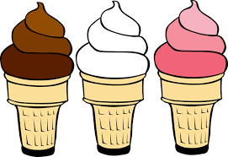

Slide 3
What do you like to do during the summer?
Played in a baseball game
Ate ice cream
Read different books
Swimming at the pool
Spent time with friends
Went on a trip

Slide 4
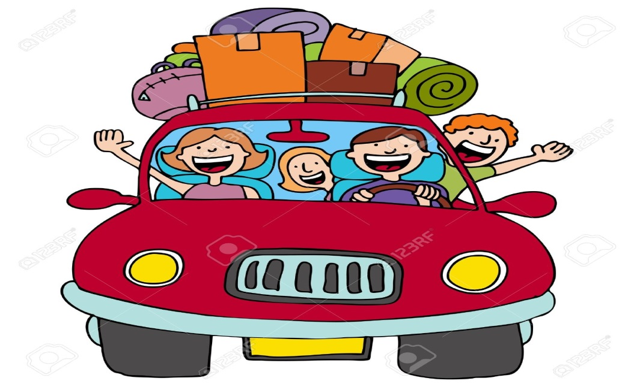
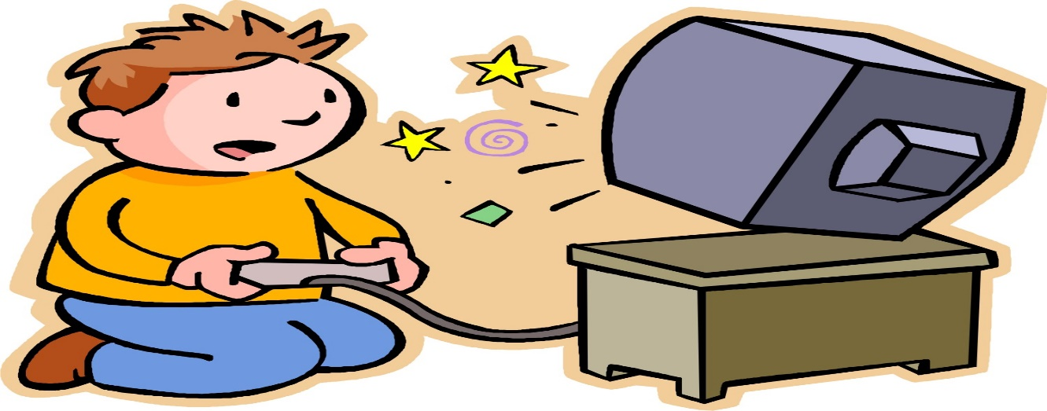
Let’s Create a New Section:
I went to ……
I did …………

Slide 5
I
played
base-
ball.
I
ate
ice
cream.
I
read
many
books.

Slide 6
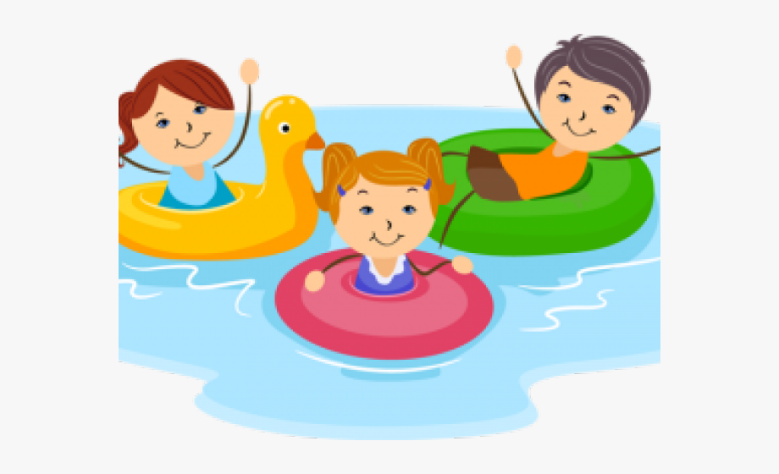
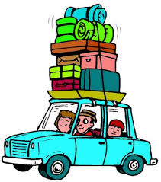
I
went
swim-
ming.
I
hung
out
with
friends.
I
went
on a
trip.

Slide 8
G
E
E
D
D
C
C

Slide 9
